Slide 1
TVA .NET Code Library Overview
.NET Reusability Committee

Slide 2
Agenda
Conduct an informal catechism for understanding the TVA .NET Common Code Library which should answer the following questions:
Why have a common code library?
What’s in the library?
Where do I get the library?
How do I start using the library?
How do I add code to the library?

Slide 3
Why have a common code library?
Standards
Standards in development make projects easier to maintain. The developer of an application may not be the same person who ends up maintaining the code.
Speed
The component model says: “It’s faster not to reinvent the wheel” (not to mention cheaper)
Reliability
Reusing battle hardened tested code will produce more reliable applications. This is critical in this type of environment.
But we all know the real reason…

Slide 4
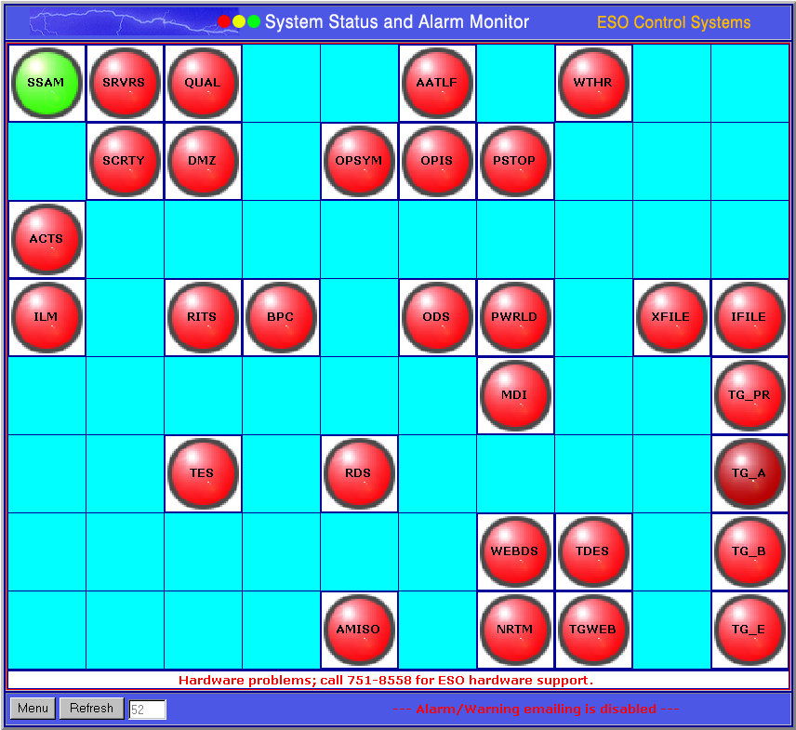

Slide 5
What’s in the library?
The TVA code library currently consists of 13 separate .NET assemblies (DLL’s) and one shared executable.
The assemblies contain compiled .NET
    Components
    Classes and
    Global Functions

Slide 6
The Assemblies…
TVA.ASP.dll (VB.NET)
TVA.Compression.dll (VC++.NET)
TVA.Config.dll (VB.NET)
TVA.Database.dll (VB.NET)
TVA.ErrorManagement.dll (VB.NET)
TVA.ESO.DataConnections.dll (VB.NET)
TVA.ESO.Ssam.dll (VB.NET)
TVA.FTP.dll (VB.NET)
TVA.Remoting.dll (VB.NET)
TVA.Services.dll (VB.NET)
TVA.Threading.dll (VB.NET)
TVA.VarEval.dll (JScript.NET)

Slide 7
TVA Namespace Overview
TVA
ASP (TVA.ASP.dll)
Compression (TVA.Compression.dll)
Config (TVA.Config.dll)
Database (TVA.Database.dll)
ErrorManagement (TVA.ErrorManagement.dll)
ESO
Ssam (TVA.ESO.Ssam.dll)
DataConnections (TVA.ESO.DataConnections.dll)
Forms
FTP (TVA.FTP.dll)
Remoting (TVA.Remoting.dll)
SecureProvider
Services (TVA.Services.dll)
Testing
Threading (TVA.Threading.dll)

Slide 8
TVA
ESO
ASP
Database
DataConnections
Ssam
Compression
Config
TVA Namespace Hierarchy
ErrorManagement
FTP
Forms
Remoting
Services
SecureProvider
Testing
Threading

Slide 9
TVA.Config
The TVA.Config namespace is the container for any components, classes or common functions related to handling application settings and configuration variables and their associated XML based config files (e.g.: app.config or web.config).
Common Global Functions
Defines common global functions related to compression.
ApplicationVariables Component Class
Defines a class that can read and write typed application variables to an application’s app.config file.
ApplicationSettings Component Class
Defines a class that can read and write standard appSetting values to an application’s app.config file.

Slide 10
TVA.Config.ApplicationSettings

Slide 11
TVA.Config.ApplicationVariables

Slide 12
TVA.Database
The TVA.Database namespace is the container for any components, classes or common functions related to database interactions.
Common Global Functions
Defines common global functions related to data access.
ActivityLogger Component Class
This class queues up status log entries for delayed writes on a timer thread so that status postings can be logged as much as needed without causing delays in general processing.
Schema Component Class
Provides a detailed schema analysis including referential information of a given oledb connection revealed through a hierarchical collection of tables, fields and foreign key relationship classes.
SQLGenerator Component Class
Defines a class that can automatically generate properly formatted Update and Insert SQL statements for a given schema.

Slide 13
TVA.Database.Common

Slide 14
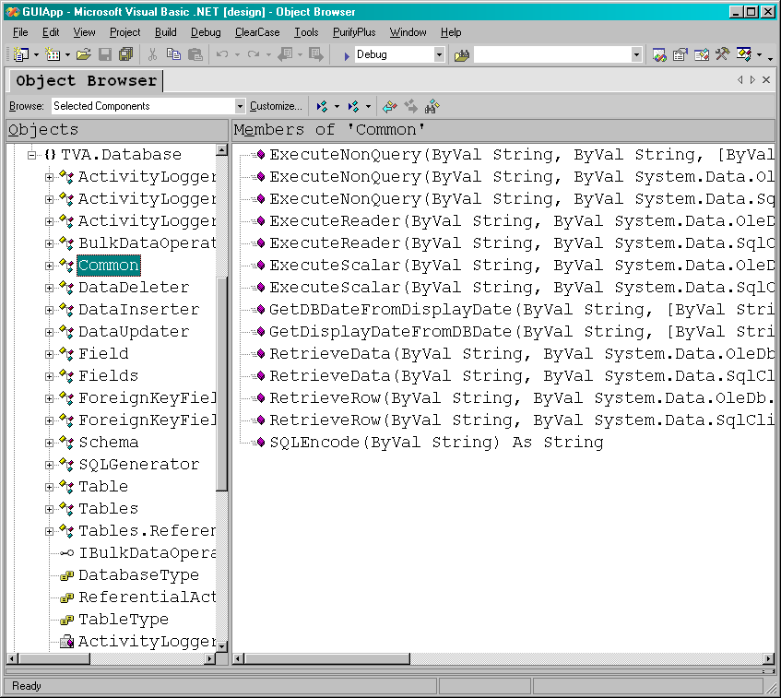

Slide 15
TVA.Database.ActivityLogger

Slide 16
TVA.Database.Schema

Slide 17
TVA.Database.SQLGenerator

Slide 18
TVA.Database
(Continued…)
The TVA.Database namespace is the container for any components, classes or common functions related to database interactions.
The following database component classes perform bulk data operations using a source and destination schema.
DataDeleter Component Class
Deletes all records in destination that exist in the source.
DataInserter Component Class
Inserts all records from the source into the destination.
DataUpdater Component Class
Updates all records in destination that exist in the source.
Notes:
Describe when the use of these classes would be appropriate.

Slide 19
TVA.Database.DataDeleter

Slide 20
TVA.Database.DataInserter

Slide 21
TVA.Database.DataUpdater

Slide 22
TVA.ESO
The TVA.ESO namespace is the container for any components, classes or common functions specific to Electric Systems Operations
Ssam Namespace
Namespace for all System Status and Alarm Monitoring related classes and components.
DataConnections Namespace
Namespace for all classes and components related to the standard centralized handling of ESO data source connection strings.
Notes:
Describe when the use of these classes would be appropriate.

Slide 23
TVA.ESO.Ssam
The TVA.ESO.Ssam namespace is the container for any components, classes or common functions related to the System Status and Alarm Monitoring system.
SsamApi Component Class
Application programming interface used for logging messages to Ssam system.
SsamLogger Component Class
This class queues up Ssam log entries for delayed writes on a timer thread so that postings can be logged as much as needed without causing delays in general processing.
Notes:
Describe when the use of these classes would be appropriate.

Slide 24
TVA.ESO.Ssam.SsamApi

Slide 25
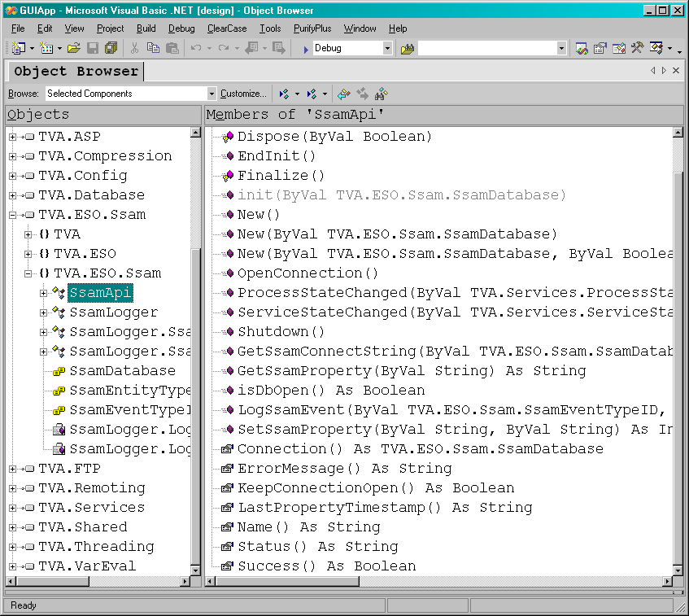

Slide 26
TVA.ESO.Ssam.SsamLogger

Slide 27
TVA.Shared
The TVA.Shared namespace is the container for any general use or convenience functions designed to speed development in .NET.
Bit Global Functions
Defines common global functions related to bit manipulation.
Common Global Functions
Defines a set of miscellaneous global .NET functions.
Crypto Global Functions
Defines a common set of cryptographic functions.
DateTime Global Functions
Defines common global functions related to Date / Time manipulation.
FilePath Global Functions
Defines common global functions related to File / Path manipulation.
Mail Global Functions
Defines common global functions related to sending e-mail from .NET.
String Global Functions
Defines common global functions related to String manipulation.

Slide 28
TVA.Shared.Bit

Slide 29
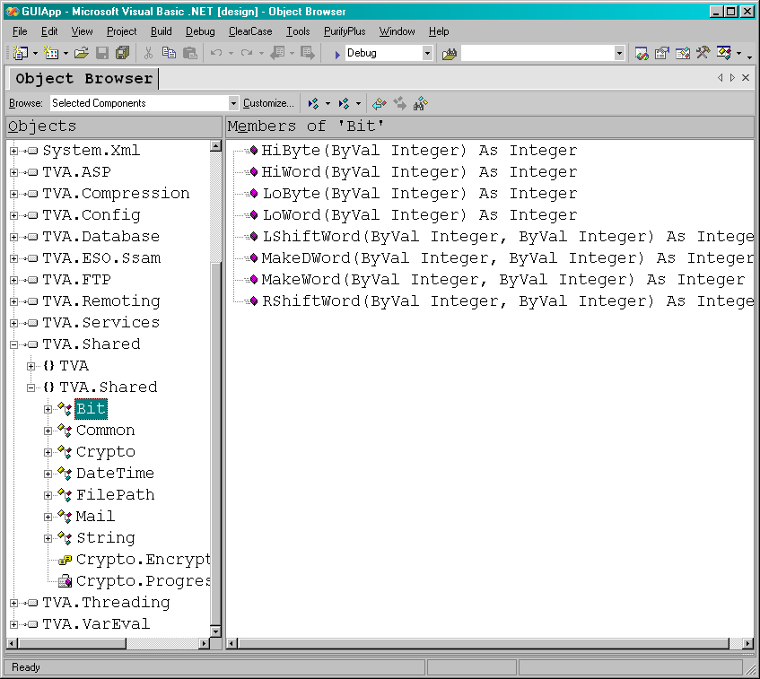

Slide 30
TVA.Shared.Common

Slide 31
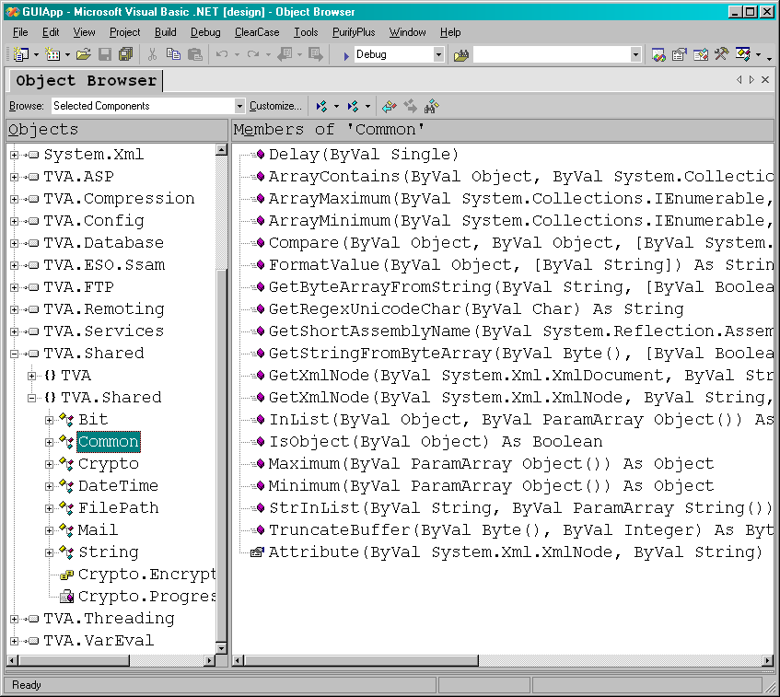

Slide 32
TVA.Shared.Crypto

Slide 33
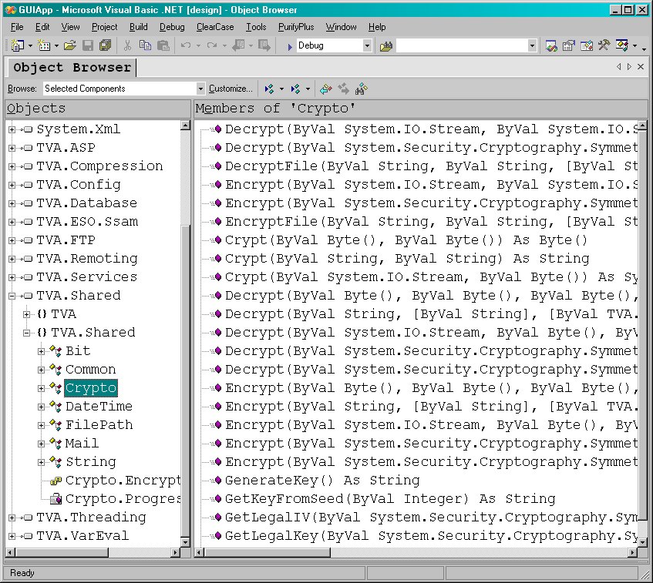

Slide 34
TVA.Shared.DateTime

Slide 35
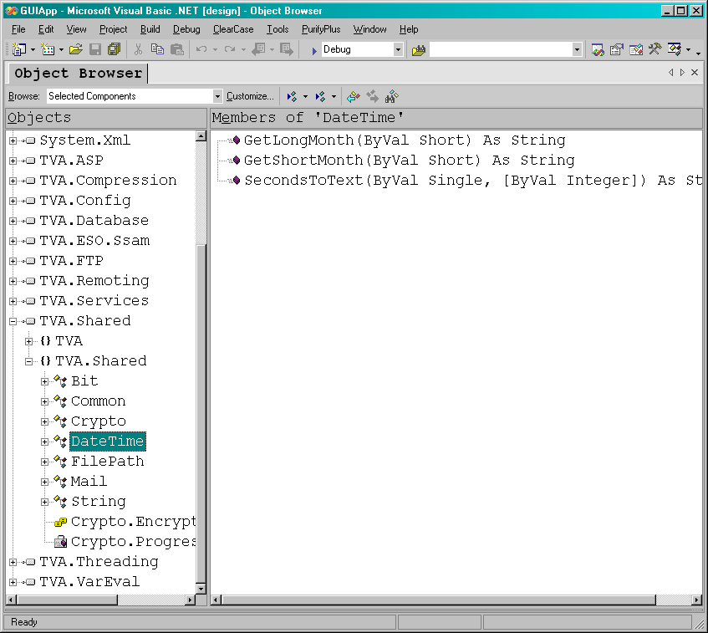

Slide 36
TVA.Shared.FilePath

Slide 37
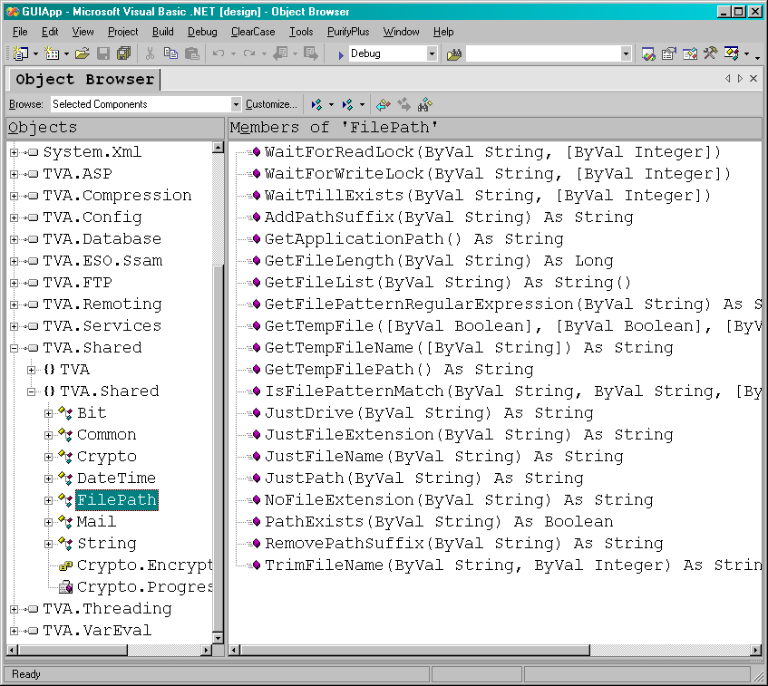

Slide 38
TVA.Shared.Mail

Slide 39
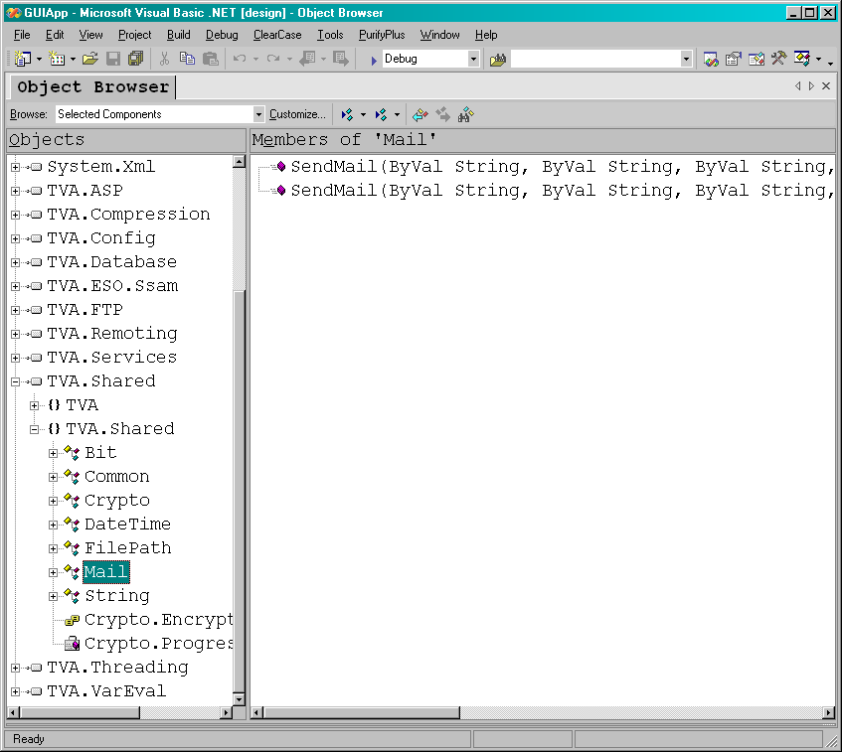

Slide 40
TVA.Shared.String

Slide 41
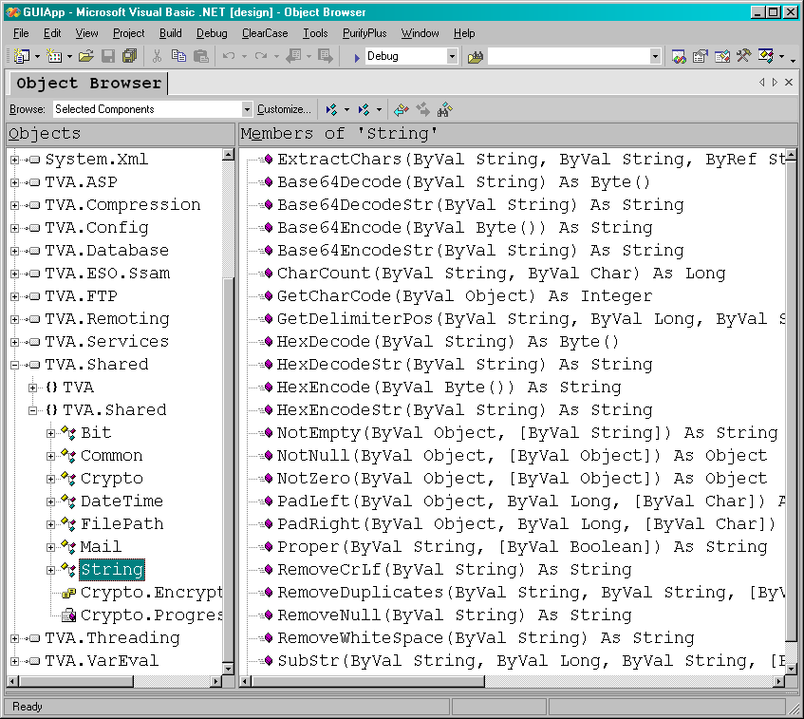

Slide 42
TVA.FTP
The TVA.FTP namespace is the container for any components, classes or common functions related to File Transfer Protocol (FTP) interactions.
Session Component Class
Creates an FTP session that can be used to connect to an FTP server to send and receive files.
FileWatcher Component Class
Monitors a directory on an FTP server for new or deleted files.

Slide 43
TVA.FTP.Session

Slide 44
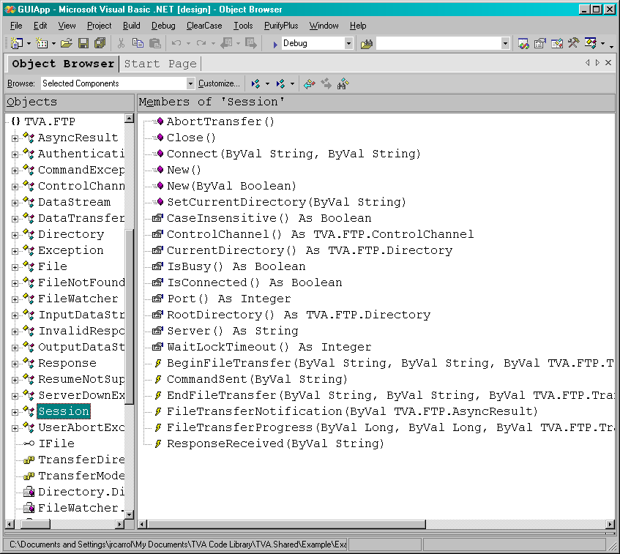

Slide 45
TVA.FTP.FileWatcher

Slide 46
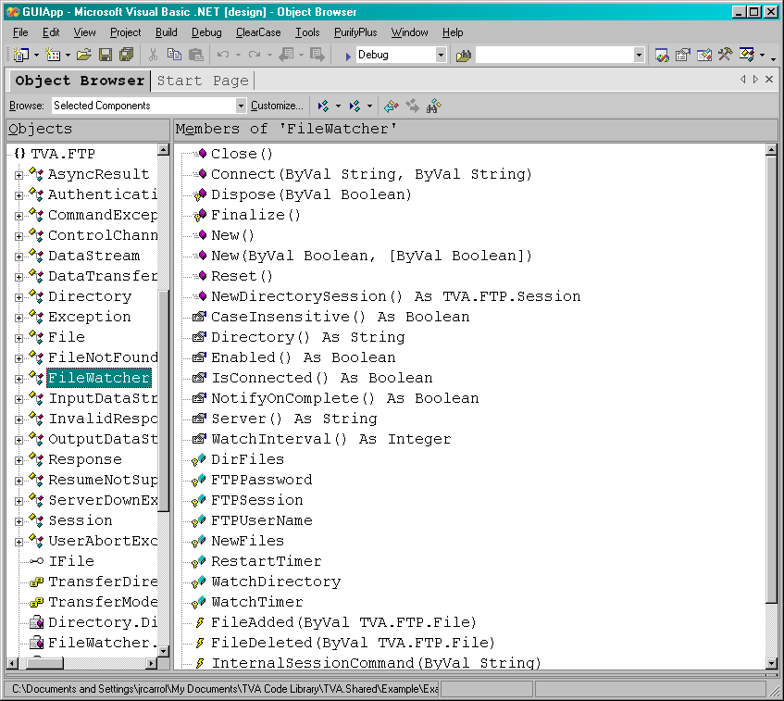

Slide 47
TVA.Compression
The TVA.Compression namespace is the container for any components, classes or common functions related to compression or zip archive manipulation.
Common Global Functions
Defines common global functions related to compression.
ZipFile Component Class
Defines a class for creating and manipulating standard zip archives.

Slide 48
TVA.Compression.Common

Slide 49
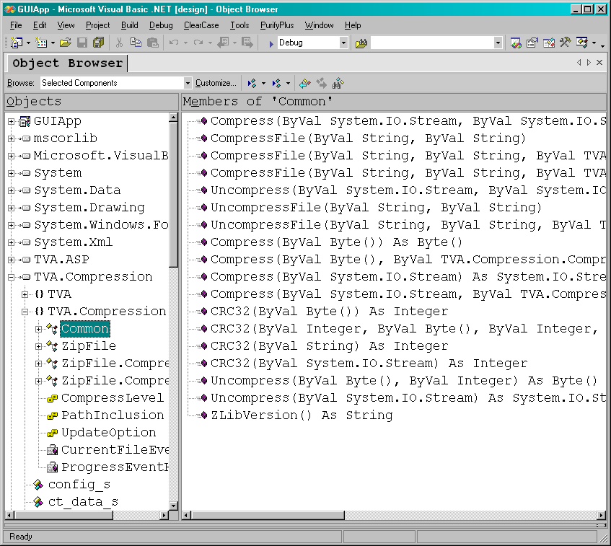

Slide 50
TVA.Compression.ZipFile

Slide 51
TVA.Remoting
The TVA.Remoting namespace is the container for any components, classes or common functions related to Remote Procedure Calls (RPC) and general inter-process communications in .NET.
IClient Interface
Defines a client interface used for interprocess communications that when implemented uses serialization to interact with an IServer instance.
IServer Interface
Defines a server interface used for interprocess communications that when implemented uses serialization to interact with IClient instances.
Flavors Component Classes
BinaryServer BinaryClient Binary Serialization
SoapServer SoapClient Soap Serialization
SecureServer SecureClient Encrypted Serialization
Notes:
Discuss when you would use binary, soap and secure servers. When talking about secure remoting – mention that it is based on a secure provider interface that should work with any .NET remoting including web services.

Slide 52
TVA.Remoting.IClient

Slide 53
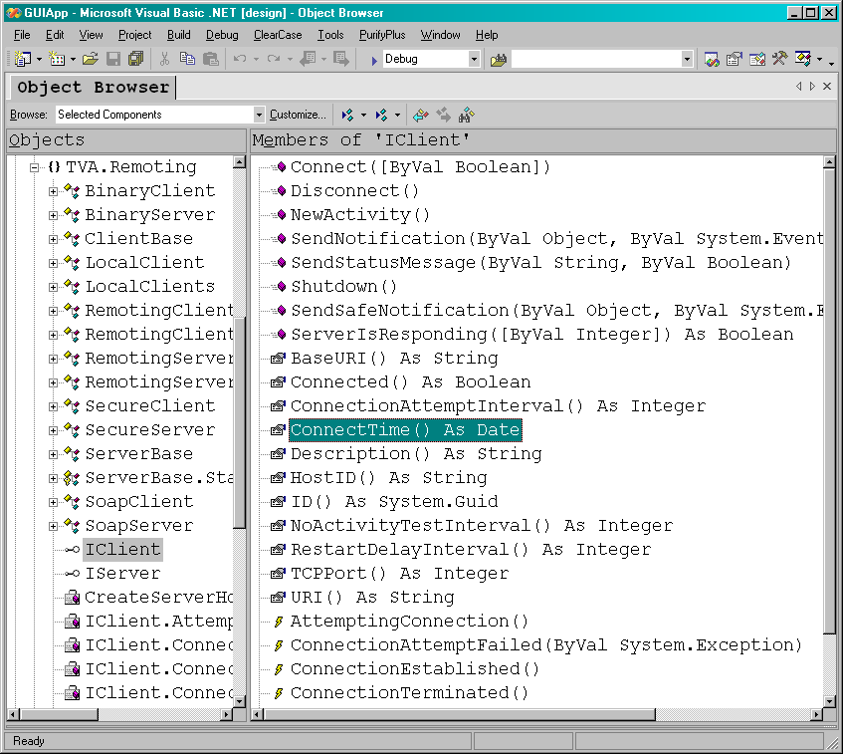

Slide 54
TVA.Remoting.IServer

Slide 55
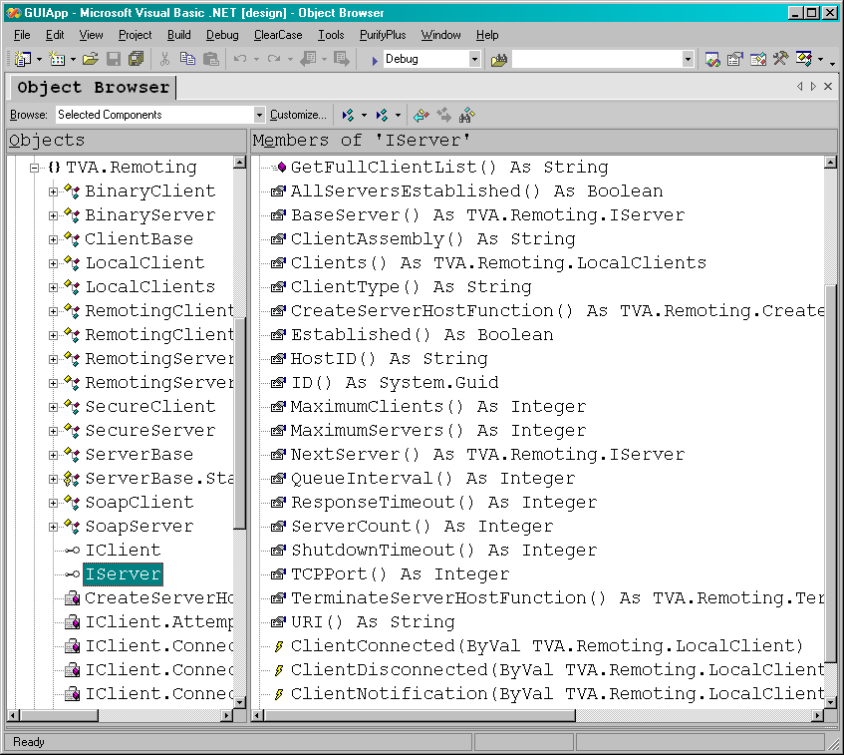

Slide 56
TVA.Services
The TVA.Services namespace is the container for any components, classes or common functions related to Windows Service applications written in .NET.
ServiceHelper Component Class
Create a valuable set of common functionality for Windows Services, including the ability to remotely monitor and control the service.
ServiceMonitor Component Class
Extends any standard remoting client class to handle standard Windows Service related messages sent from ServiceHelper.

Slide 57
TVA.Services.ServiceHelper

Slide 58
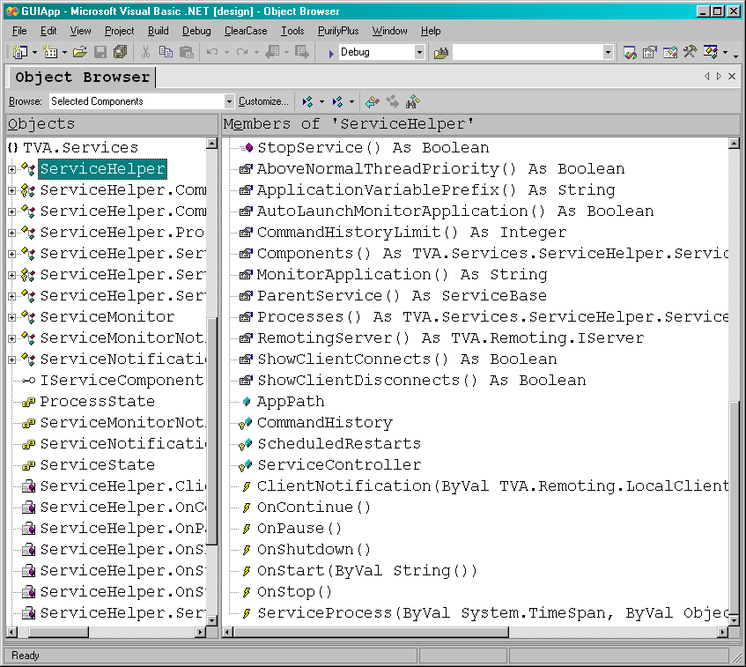

Slide 59
TVA.Services.ServiceMonitor

Slide 60
TVA.Threading
The TVA.Threading namespace is the container for any components, classes or common functions related to threading in .NET.
RunThread Class / Global Functions
Defines a class that can execute any existing function on a thread. This class uses reflection to invoke an existing sub or function on a new thread, its usage can be as simple as:
RunThread.ExecuteMethod(Me, "MyMethod", "param1", True)
ThreadBase MustInherit Class
Defines a convenient base class for new threads. Deriving your own thread class from this class ensures your thread will properly terminate when your object is ready to be garbage collected and allows you to define properties for the needed parameters of your thread proc.

Slide 61
TVA.Threading.RunThread

Slide 62
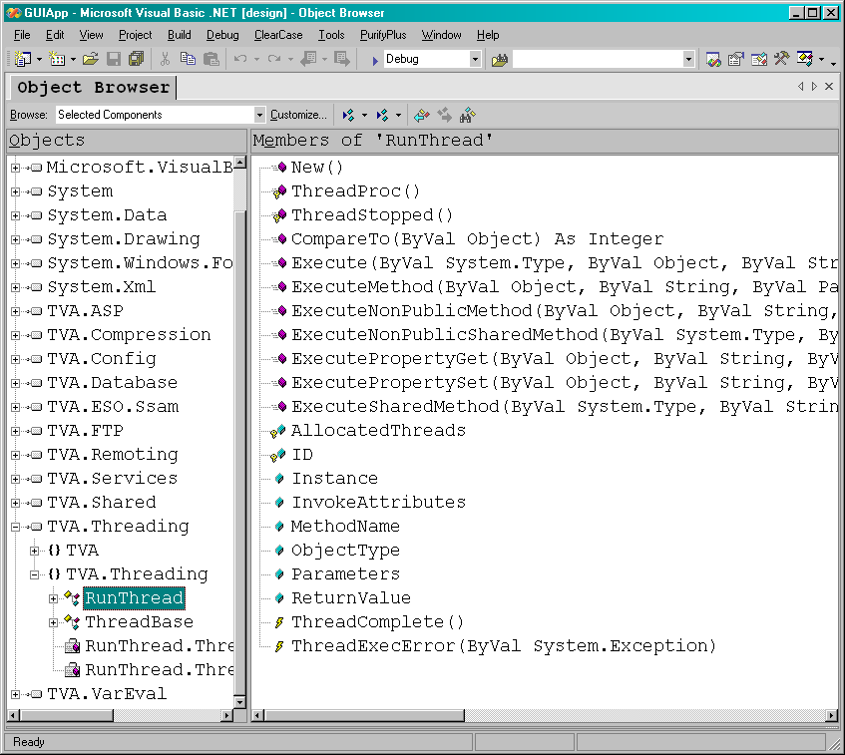

Slide 63
TVA.Threading.ThreadBase

Slide 64
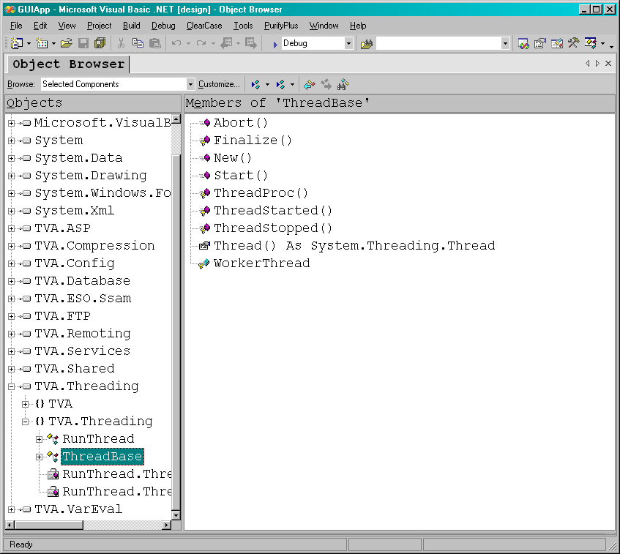

Slide 65
TVA.ASP
The TVA.ASP namespace is the container for any components, classes or common functions related to ASP.NET development.
BasePage Global Functions (via inheritance)
Defines a base page for ASP.NET web pages that automatically defines many convenient web page related functions.
Common Global Functions
Defines common global functions related to web development.
VarInit Global Functions
Defines global functions that load application and session scope variables persisted in a database connection or a XML based configuration file for a web application.

Slide 66
TVA.ASP.BasePage

Slide 67
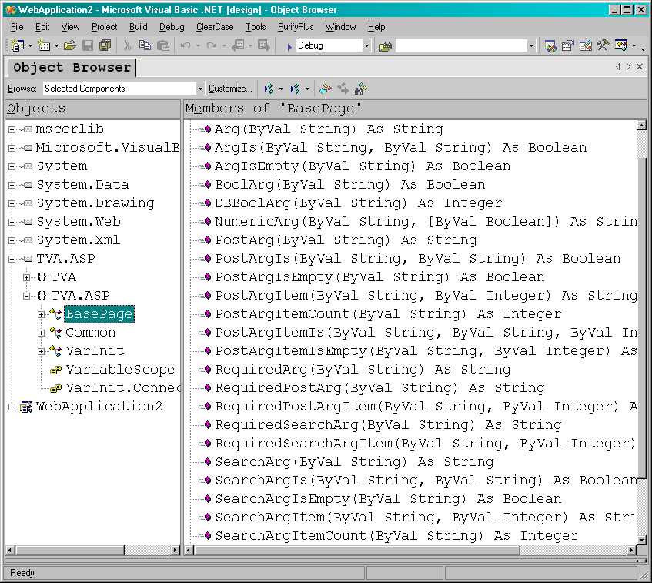

Slide 68
TVA.ASP.Common

Slide 69
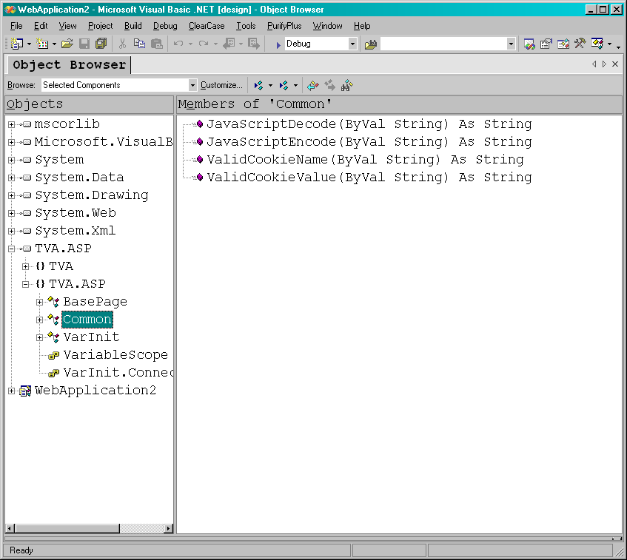

Slide 70
TVA.ASP.VarInit

Slide 71
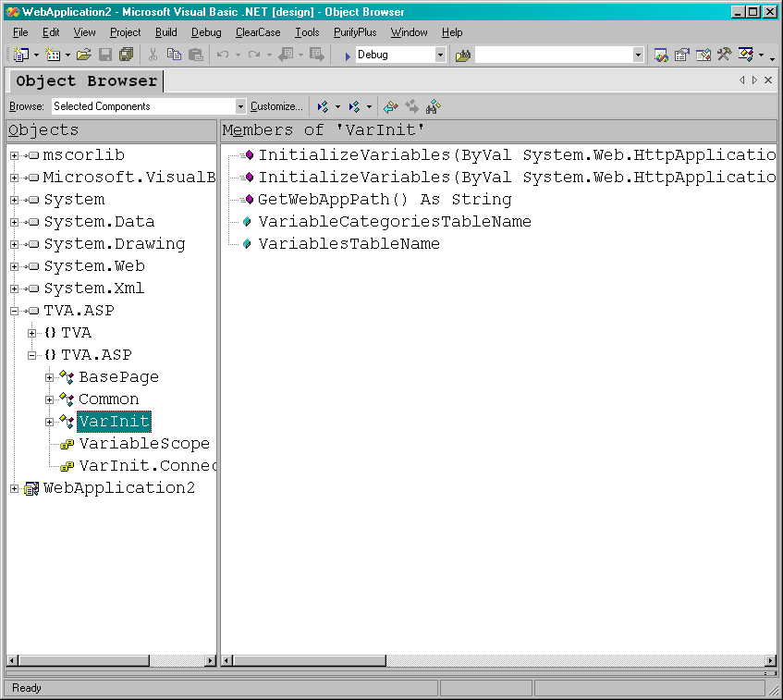

Slide 72
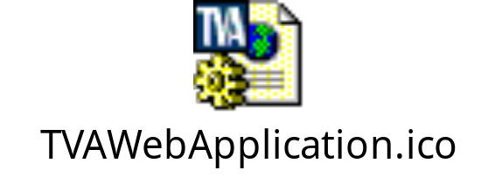
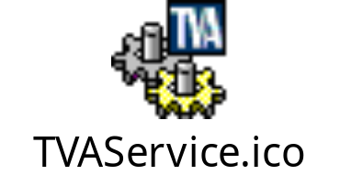
Upcoming Additions…
TVA.ESO.DataConnections:
Data Connection Components
TVA.ErrorManagement:
Global Error Management Components
TVA.Shared.DateTime:
New TimeZone Management Classes
TVA Project Templates:
ASP.NET / Windows Service / GUI App

Slide 73
Intellisense Documentation
<?xml version="1.0" ?>
<doc>
<assembly>
<name>TVA.ASP</name>
</assembly>
<members>
<member name="T:TVA.ASP.BasePage">
<summary>Base page for ASP.NET pages</summary>
</member>
<member name="M:TVA.ASP.BasePage.Arg(System.String@)">
<summary>
Argument shortcut function
</summary>
<param name="Name">Argument name</param>
</member>
</members>
</doc>

Slide 74
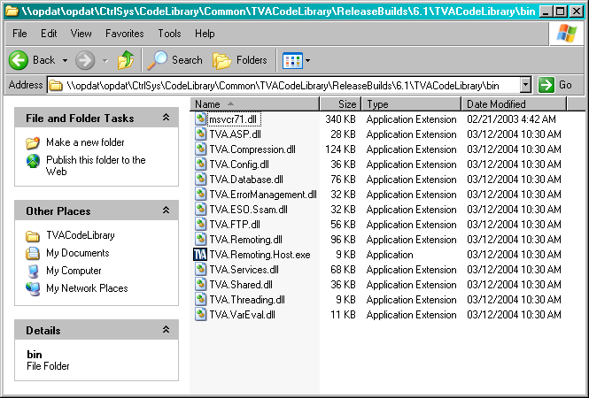
Where do I get the library?
The T: drive (\\opdat\opdat):
\\opdat\opdat\CtrlSys\CodeLibrary\Common\TVACodeLibrary\ReleaseBuilds\6.1

Slide 75
How do I start using the library?
Add designable components to your Visual Studio toolbox and start dragging desired components onto design surfaces.
Reference desired assemblies in your projects directly off of T:\ drive – or copy the assemblies locally to improve project load performance. If copied locally, please make sure you place the assemblies in:
<My Documents>\Visual Studio Projects\TVACodeLibrary\bin
to make sure everyone can properly load your project if needed.

Slide 76
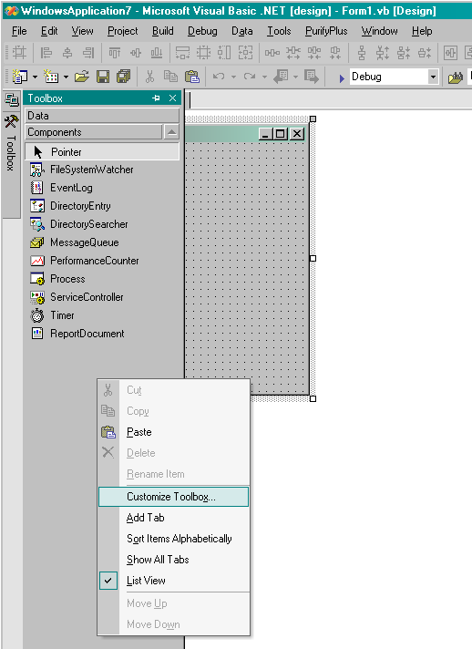
Adding Components to Visual Studio
Many of the assemblies in the shared code library contain designable components. To add a component to your Visual Studio development environment, open a project, click the Toolbox tab, select Components, then right click on the component list and select Customize Toolbox:

Slide 77
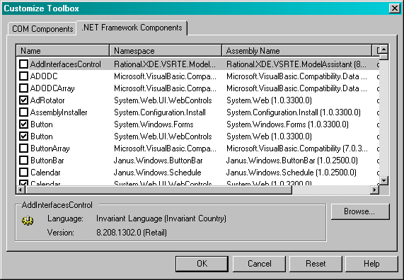
Adding Components to Visual Studio
(Continued…)
When the Customize Toolbox dialog appears, select the .NET Framework Components tab and click Browse:

Slide 78
How do I add code to the library?
Create a test script for your code. This doesn’t have to fancy, but it’s preferred if it works using the TVA test bed (\\opdat\opdat\CtrlSys\CodeLibrary\Common\Testing)
Send component description to the ESO Dot Net Reuse Committee (DNRC) e-mail group
If your code is approved for inclusion, the DNRC will give you a namespace assignment for your code or component
Place your code or component in the given namespace and rerun the test script to make sure your code still works after this change
Send code and test script to DNRC for library integration
That’s it!

Slide 79
Digression
Web Services and Web Data Sources
1) A web service is essentially a “class” hosted in IIS that remote clients can get an instance of and use. This is ideal for creating a “centralized” object that remote clients can use to initiate events on a server and get a response. For example: a client can make a request from a centralized “Load Forecasting Object” to calculate tomorrows expected load. This is truly a remote method invocation.
A web data source, on the other hand, is simply a URL setup to return a data stream such as XML.

Slide 80
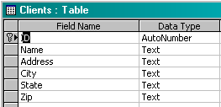
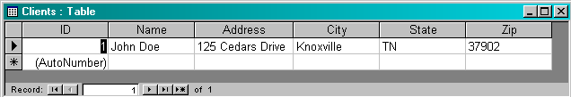
Example Data Structure

Slide 81
Example XML Format
<?xml version="1.0" encoding="utf-8" ?>
<client>
<id>12</id>
<name>John Doe</name>
<address>125 Cedars Drive</address>
<city>Knoxville</city>
<state>TN</state>
<zip>37902</zip>
</client>

Slide 82
File Centric Overview
File Based Data Provider :
If file exists, wait for write lock
Write data file
File Based Data Consumer:
If file exists, wait for read lock
Read data file
Lot’s of waiting and watching for files…

Slide 83
Web Data Overview
Web Based Data Provider:
Write data stream (HTTP or other)
Web Based Data Consumer:
Read data stream
All data delivered as needed on demand…

Slide 84
Differences at the Client
Client using File Data Source:
Dim xmlDoc As New Xml.XmlDocument
Dim fileName As String = "C:\DataFile.xml“
xmlDoc.Load(fileName)
Client using Web Data Source:
Dim xmlDoc As New Xml.XmlDocument
Dim url As String = “http://localhost/GetData.aspx?ID=1"
xmlDoc.Load(CType(WebRequest.Create(url), _ HttpWebRequest).GetResponse.GetResponseStream)

